Slide 1
Transmission
Control Protocol

Slide 2
CONGESTION CONTROL
Congestion control refers to the mechanisms and techniques to keep the load below the capacity.
The topics discussed in this section include:
Congestion Control Mechanisms
Congestion Control in TCP

Slide 3
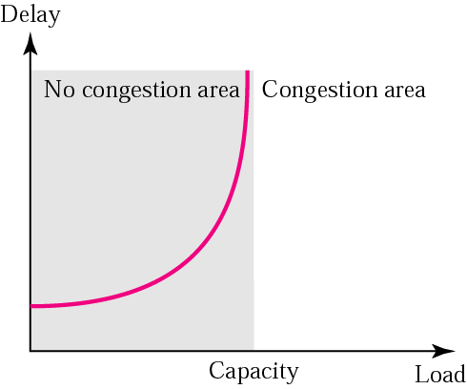
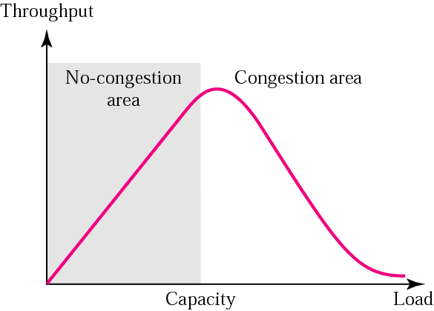
Packet delay and network load
Throughput versus network load

Slide 4
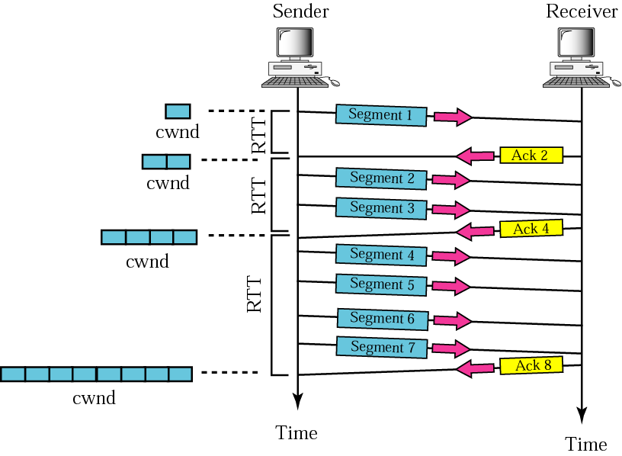
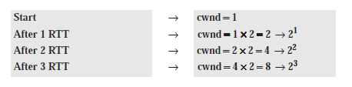
TCP CONGESTION CONTROL: (1) Slow start, exponential increase
The size of the window increases one MSS each time one ACK arrives.
In the slow start algorithm, the size of the congestion window increases exponentially until it reaches a threshold called ssthreshold

Slide 5
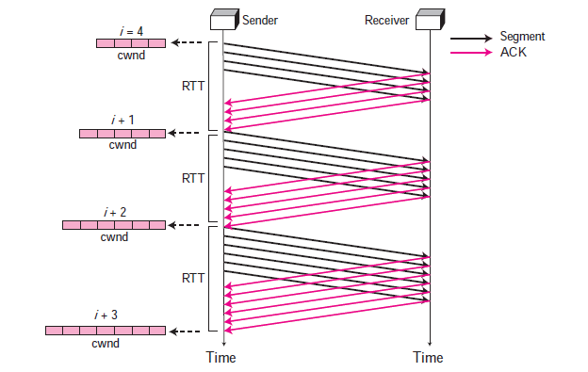
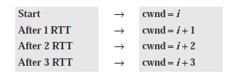
TCP CONGESTION CONTROL: (2) additive increase
IMP: In this phase, each time the whole “window” of segments is acknowledged, the size of the congestion window is increased by one. A window is the number of segments transmitted during RTT. In other words, the increase is based on RTT, not on the number of arrived ACKs.

Slide 6
TCP CONGESTION CONTROL: (3) Multiplicative Decrease
When Congestion Occurs:
Retransmission can occur in one of two cases: when the RTO timer times out or when three duplicate ACKs are received. In both cases, the size of the threshold is dropped to half (multiplicative decrease). Most TCP implementations have two reactions:
1. If a time-out occurs, there is a stronger possibility of congestion; a segment has probably been dropped in the network and there is no news about the following sent segments. In this case TCP reacts strongly:
a. It sets the value of the threshold to half of the current window size.
b. It reduces cwnd back to one segment.
c. It starts the slow start phase again.
2. If three duplicate ACKs are received, there is a weaker possibility of congestion; a segment may have been dropped but some segments after that have arrived safely since three duplicate ACKs are received. This is called fast transmission and fast recovery. In this case, TCP has a weaker reaction as shown below:
a. It sets the value of the threshold to half of the current window size.
b. It sets cwnd to the value of the threshold (some implementations add three segment sizes to the threshold).
c. It starts the congestion avoidance phase.

Slide 7
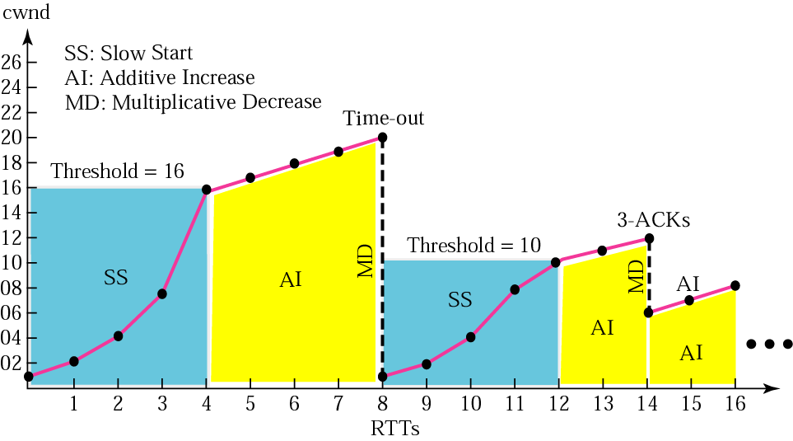
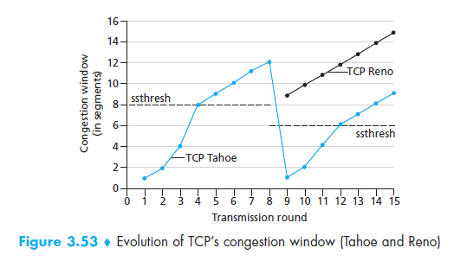
Figure 12.36 Congestion example

Slide 8
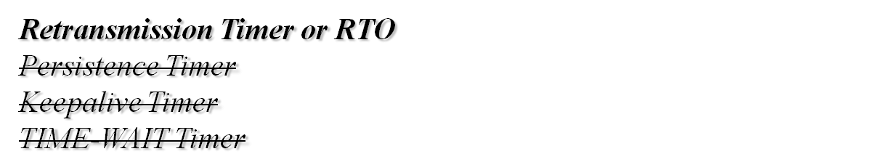
TCP TIMERS
To perform its operation smoothly, most TCP implementations use at least four timers.
The topics discussed in this section include:

Slide 9

Note: V Imp
In TCP, there can be only be one RTT measurement in progress at any time.

Slide 10

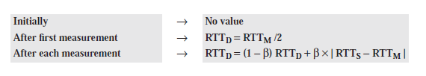

RTO Calculation
Round-Trip Time (RTT): Time spent in sending a segment and receiving it’s ACK
Measured RTT: In TCP, there can be only be one RTT measurement in progress at any time. We need to find how long it takes to send a segment and receive an acknowledgment for it. This is the measured RTT. Use the notation RTTM to stand for measured RTT.
Smoothed RTT : RTTS, is a weighted average of RTTM and the previous RTTS as shown below: old RTT_{S}
The value of α is implementation-dependent, but it is normally set to 1/8. In other words, the new RTT_{S} is calculated as 7/8 of the old RTTS and 1/8 of the current RTTM.
RTT Deviation: RTTD is calculated based on the RTTS and RTTM using the following formulas: old RTT_{D}
The value of β is also implementation-dependent, but is usually is set to 1/4.
4. Retransmission Time-out (RTO): The value of RTO is based on the smoothed round-trip time and its deviation. Following formula to calculate the RTO:
RTT_{D}

Slide 11
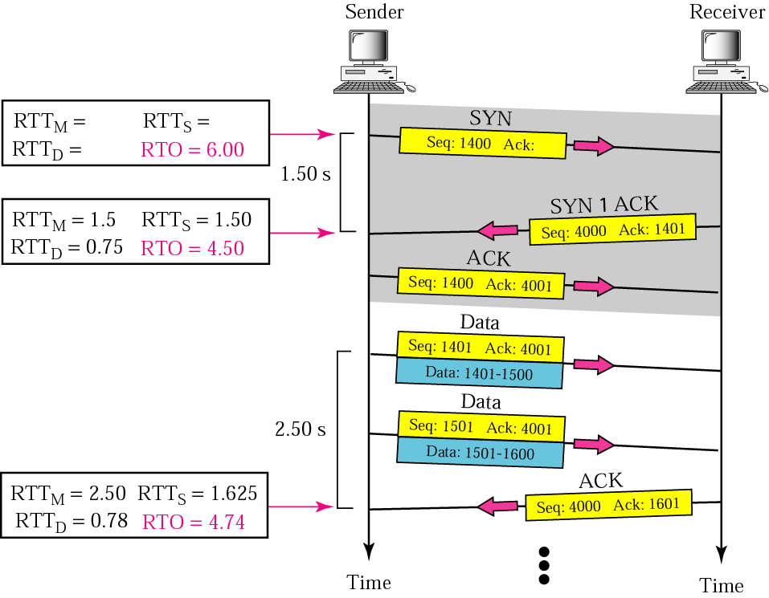
Example
1. When the SYN segment is sent, there is no value for RTT_{M} , RTT_{S} , or RTT_{D} . The value of RTO is set to 6.00 seconds. The following shows the value of these variables at this moment:
2. When the SYN+ACK segment arrives, RTT_{M} is measured and is equal to 1.5 seconds.
RTT_{M} = 1.5, RTT_{S} = 1.5,
RTT_{D} = 1.5 / 2 = 0.75,
RTO = 1.5 + 4 . 0.75 = 4.5
3.When the first data segment is sent, a new RTT measurement starts. Note that the sender does not start an RTT measurement when it sends the ACK segment, because it does not consume a sequence number and there is no time-out. No RTT measurement starts for the second data segment because a measurement is already in progress.
RTT_{M} = 2.5
RTT_{S} = 7/8 (1.5) + 1/8 (2.5) = 1.625
RTT_{D} = 3/4 (7.5) + 1/4 |1.625 − 2.5| = 0.78
RTO = 1.625 + 4 (0.78) = 4.74

Slide 12
Note:
TCP does not consider the RTT of a retransmitted segment in its calculation of a new RTO.

Slide 13
RTT Sample Ambiguity
Karn’s Algorithm
A
B
A
B
Original transmission
Original transmission
X
RTO
RTO
ACK
Sample
RTT
Sample
RTT
retransmission
retransmission
ACK
Suppose that a segment is not acknowledged during the retransmission timeout period and is therefore retransmitted. When the sending TCP receives an acknowledgment for this segment, it does not know if the acknowledgment is for the original segment or for the retransmitted one. The value of the new RTT is based on the departure of the segment.
However, if the original segment was lost and the acknowledgment is for the retransmitted one, the value of the current RTT must be calculated from the time the segment was retransmitted. This ambiguity was solved by Karn. Karn’s algorithm is simple. Do not consider the round-trip time of a retransmitted segment in the calculation of RTTs. Do not update the value of RTTs until you send a segment and receive an acknowledgment without the need for retransmission.

Slide 14
Exponential Backoff
What is the value of RTO if a retransmission occurs?
Most TCP implementations use an exponential backoff strategy. The value of RTO is doubled for each retransmission.
So if the segment is retransmitted once, the value is two times the RTO. If it transmitted twice, the value is four times the RTO, and so on.

Slide 15
Example 11: RTO in case of Retransmissions (Exponential Backoff)
Figure 12.39 is a continuation of the previous example. There is retransmission and Karn’s algorithm is applied. The first segment in the figure is sent, but lost. The RTO timer expires after 4.74 seconds. The segment is retransmitted and the timer is set to 9.48, twice the previous value of RTO. This time an ACK is received before the time-out. We wait until we send a new segment and receive the ACK for it before recalculating the RTO (Karn’s algorithm).

Slide 16
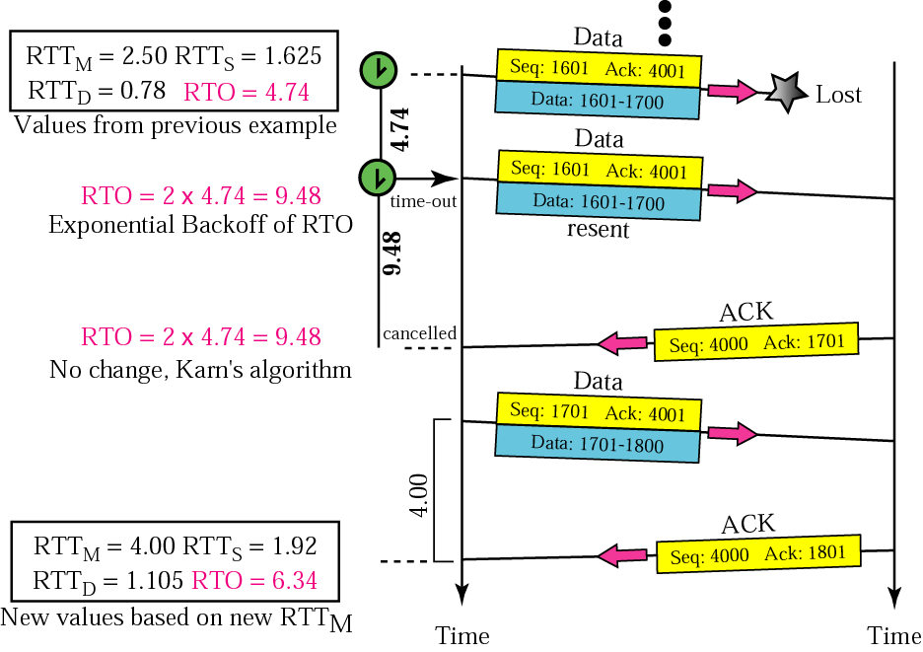
Figure 12.39 Example 11

Slide 17
A host sends five packets and receives three acknowledgments. The time is shown
as hour:minute:seconds.
  Segment 1 was sent at 0:0:00.
  Segment 2 was sent at 0:0:05.
  ACK for segments 1 and 2 received at 0:0:04.
  Segment 3 was sent at 0:0:06.
  Segment 4 was sent at 0:0:08.
  ACK for segments 3 and 4 received at 0:0:15.
  Segment 5 was sent at 0:0:16. and lost
  Segment 6 was sent at 0:0:17.
  ACK for segments 5 and 6 received at 0:0:55.
  Segment 7 sent at 0:0:56.
  Ack of segment 7 received at 0:0:70
Calculate the values of RTTM, RTTS, RTTD, and RTO if the original RTO is 6 seconds.
Did the sender miss the retransmission of any segment? Show which segments
should have been retransmitted and when. What is the RTO value used for segment 7. Rewrite the events including the retransmission time.

Slide 18
A host sends five packets and receives three acknowledgments. The time is shown
as hour:minute:seconds.
  Segment 1 was sent at 0:0:00.
  Segment 2 was sent at 0:0:05.
  ACK for segments 1 and 2 received at 0:0:07.
  Segment 3 was sent at 0:0:20.
  Segment 4 was sent at 0:0:22.
  Segment 5 was sent at 0:0:27.
  ACK for segments 1 and 2 received at 0:0:35.
  ACK for segment 3 received at 0:0:55.
Calculate the values of RTTM, RTTS, RTTD, and RTO if the original RTO is 6 seconds.
Did the sender miss the retransmission of any segment? Show which segments
should have been retransmitted and when. Rewrite the events including the
retransmission time.

Slide 19
Kurose, Chapter 3, P31:
Suppose that the five measured SampleRTT values (see Section 3.5.3) are
106 ms, 120 ms, 140 ms, 90 ms, and 115 ms. Compute the EstimatedRTT
after each of these SampleRTT values is obtained, using a value of α = 0.125
and assuming that the value of EstimatedRTT was 100 ms just before the
first of these five samples were obtained. Compute also the DevRTT after
each sample is obtained, assuming a value of β = 0.25 and assuming the
value of DevRTT was 5 ms just before the first of these five samples was
obtained. Last, compute the TCP Timeout Interval after each of these
samples is obtained.

